Slide 1
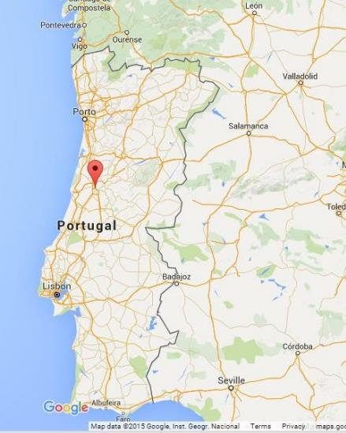

PORTUGAL – COIMBRA CiTY
COIMBRA

Slide 2

PORTUGAL – A COUNTRY OF CONTRAsT

Slide 3

POLYTECHNIC INSTITUTE OF COIMBRA
6 Schools
More than 40 courses
70 MSc and post-graduations degrees
600 professors (of which, 350 with PhD)
50 full professors
Over 12000 students

Slide 4







health & Technology
Education
Agriculture
Technology & Management
Engineering
BUSINESS

Slide 5

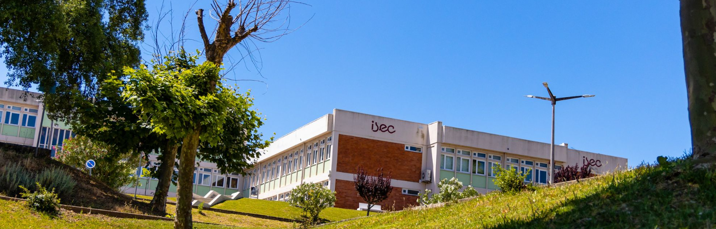

COIMBRA INSTITUTE OF ENGINEERING
POLYTECHNIC INSTITUTE OF COIMBRA

Slide 6



ISEC CAMPUS
6 Departments
84 Laboratories

Slide 7
ISEC DEPARTMENTS
CIVIL ENGINEERING
ELECTROTECHNICAL ENGINEERING
MECHANICAL ENGINEERING
INFORMATICS AND SYSTEMS ENGINEERING
CHEMICAL AND BIOLOGICAL ENGINEERING
PHYSICAL AND MATHEMATICS ENGINEERING
6

Slide 8
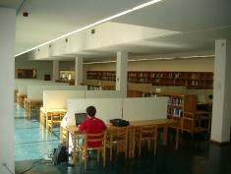
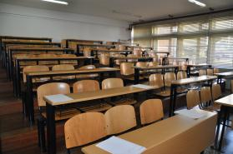
ISEC SERVICES & Facilities
Purchasing Service
Planning and Evaluation Office
Project Support Office
Image and Public Relations Office
Professional Insertion and Alumni Office
International Relations Office
Secretariat
Secretary Academic and Pedagogical Management Service
Technological Infrastructure Management Service
Facilities and Maintenance Service
Academic Treasury
Auxiliary Services
Resource Management Service
IPC's Student Support Office (GAE)
Quality Office
Social Assistance Office
Psychology Office
Library
AEISEC – Student Association
Copy Center
Study Rooms
Canteen
Cafeterias
Auditorium

Slide 9
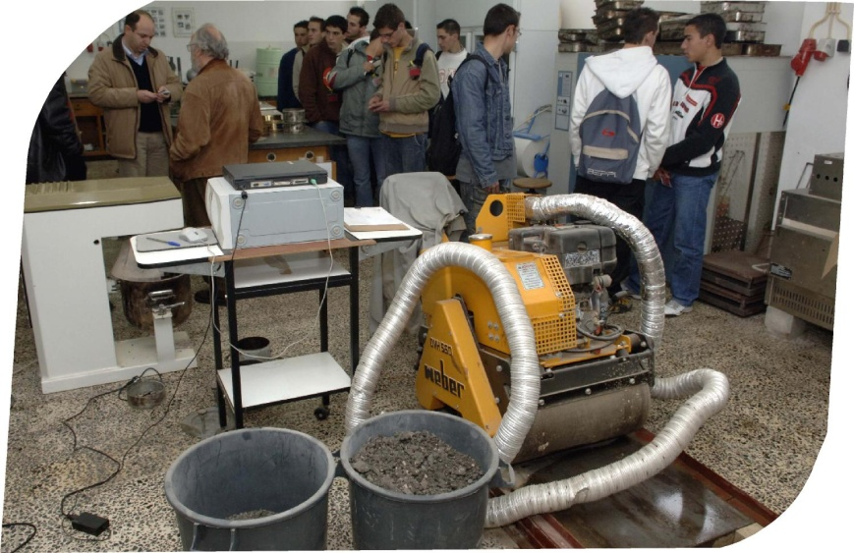
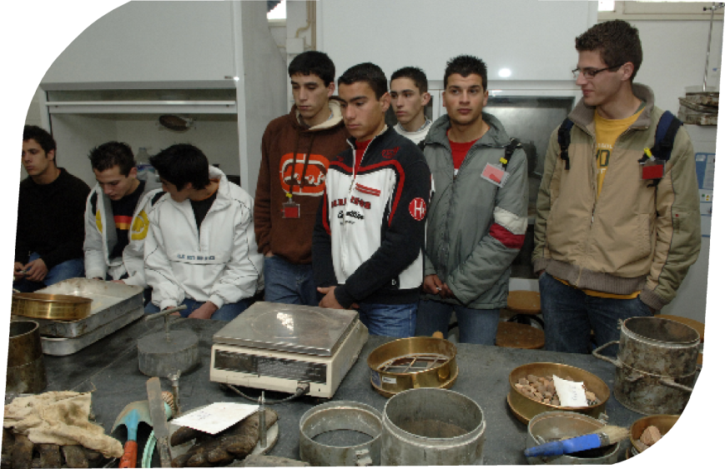
ISEC DEPARTMENT MAIN LABS
CIVIL ENGINEERING
» Geotechnical
» Hydraulics
» Computer and System
» Building Materials
» Road Pavements
» Topography

Slide 10
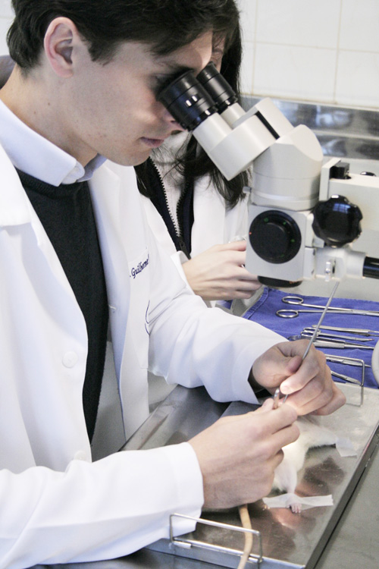
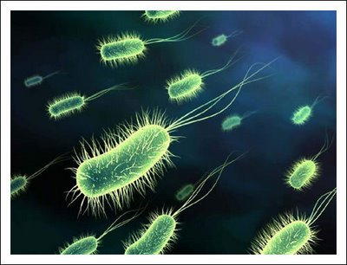
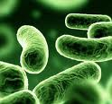
ISEC DEPARTMENT MAIN LABS
CHEMICAL AND BIOLOGICAL ENGINEERING
» Industrial Control
» Transport Phenomena
» Research Applied to Chemical Engineering
» Separation Processes
» Environmental Technology Laboratory
» Chemical Thermodynamics
» Organic Chemistry
» Analytical Chemistry
» Biochemistry and Microbiology
» Instrumental Analysis I
» Materials
» Computer

Slide 11
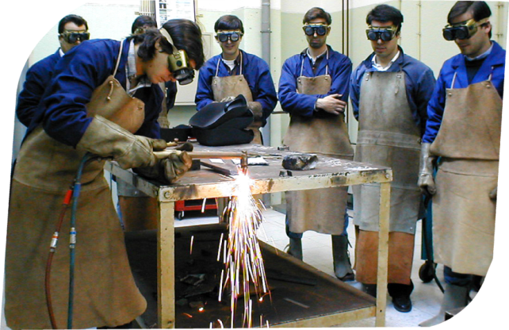
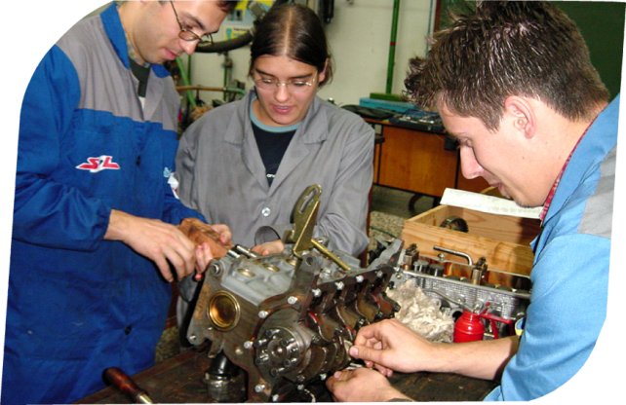
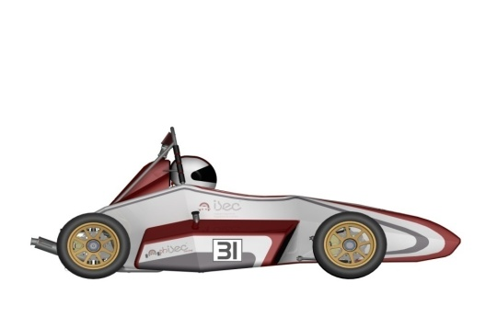
ISEC DEPARTMENT MAIN LABS
MECHANICAL ENGINEERING
» Applied Mechanics
» Materials
» Hydraulic Machines
» Project
» Welding and Thermal Cutting
» Thermal Systems
» Tribology and Maintenance
» Technology Officinal
» Heat Transfer
» Automation
» Computer Assisted Design
» CAE
» Computer Assisted Manufacturing
» Mechanical Testing
» Instrumentation and Control Systems
» Computers
» Alternatives Machines

Slide 12

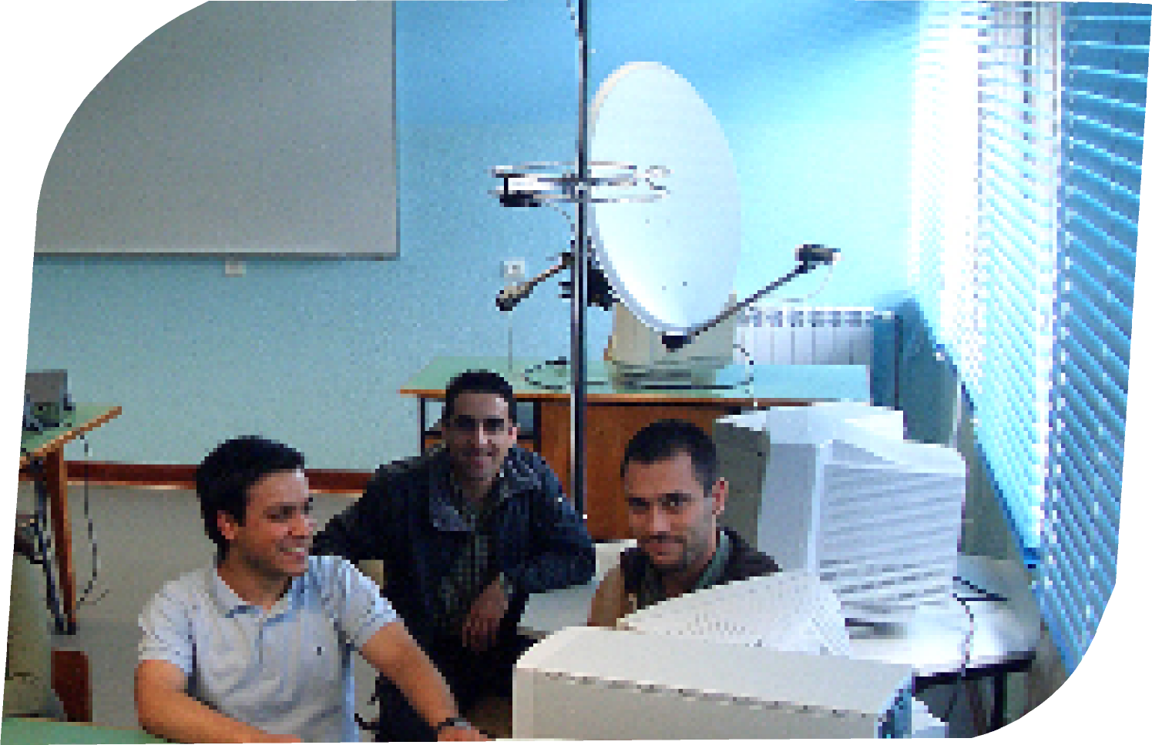
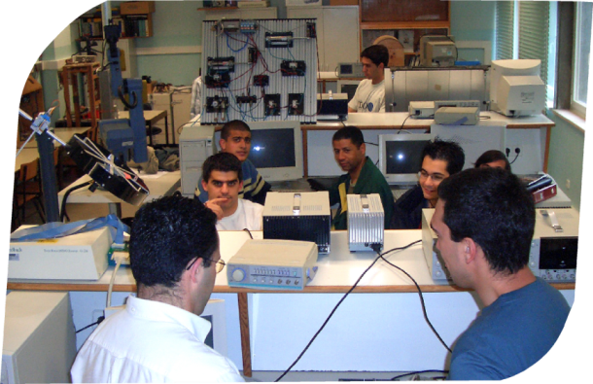
ISEC DEPARTMENT MAIN LABS
ELECTRICAL ENGINEERING
» Electrical Power Systems
» Electrical Machines
» Electromechanical Drives
» Informatics Support
» Networks
» Digital Systems
» Measurement and Instrumentation
» Electronics
» Projects
» Communications
» Energy
» Power Electronics
» Microprocessor
» Automation and Robotics

Slide 13
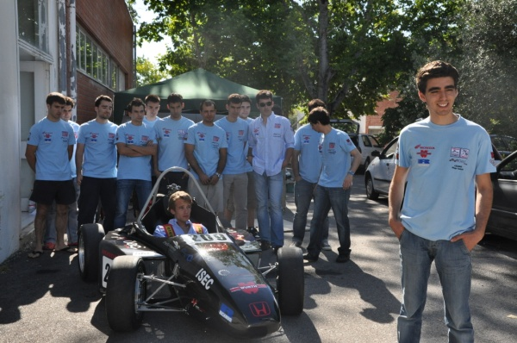
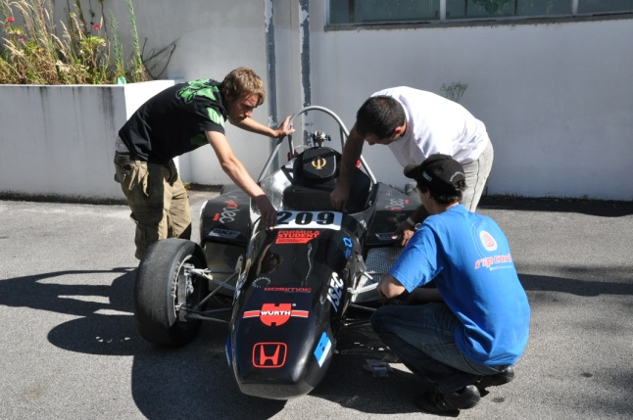
ISEC PROJECTS – Team Work
PHISEC – FORMULA STUDENTS PROJECT
This is a project for students that provides an exercise in real context of creating a fictitious company in which students have to develop a prototype race car in terms of design and manufacturing, together with the procedures involved in setting a real company for manufacturing cars, involving various technical, financial management and marketing.
This project has enabled students to develop skills in team work to strict deadlines, requiring motivation, commitment and dedication that leads to its technical and professional enrichment during his academic career.

Slide 14

ISEC AEISEC – STUDENT ASSOCIATION
The Student Association was created in 1979 with the aim of establishing a unit to defend the interests and rights of students, provide the new students with useful information about Coimbra, ISEC, sport and leisure (…)
ANNUAL EVENT
FENGE

Slide 15

ISEC DEPARTments
Civil Engineering
Chemical and Biological Engineering
Electrical Engineering
Informatics and Systems Engineering
Mechanical Engineering
Physical and Mathematics

Slide 16
ISEC Bachelors
Bioengineering
Biomedical Engineering - Bioelectronics
Civil Engineering
Electromechanical Engineering
Electrical and Computer Engineering
Industrial Engineering and Management
Informatics Engineering
European Computer Science
Sustainable City Management

Slide 17
ISEC masters degrees (2022-2024 edition)
Electric Mobility and Energy Systems (Erasmus Mundus)
Chemical and Biological Engineering
Electrical Engineering
Industrial Engineering and Management
Informatics Engineering
Mechanical Engineering
Physical Assets Engineering and Management
Sustainable and Smart Cities

Slide 18
  ISEC MOBILITY EXCHANGE

Slide 19

ISEC PRESIDENT: PROF. Mário Velindro ISEC International Coordinator: Prof. Luís Castro
Departmental Coordinators | NAME / E-mail
Informatics and Systems Eng. | Prof. Carlos Pereira, cpereira@isec.pt
Mechanical Eng. | Prof. Urbano, urbano@isec.pt
Civil Eng. | Prof. Luis Santos, lmsantos@isec.pt
Chemical and Biological Eng. | Prof. David Domingues, davidd@isec.pt
Electrical Eng. | Prof. . João Cândido, jcandido@isec.pt
Physics and Mathematics | Prof. Luís Melo, lmelo@isec.pt
ISEC INTERNATIONAL RELATIONS OFFICE ri@isec.pt

Slide 20

Thank you!
ri@isec.pt

